Slide 1
Relational Algebra
Topic 4
Readings:
Chapter 8 (in 7th edition): Relational Algebra
CS319

Slide 2
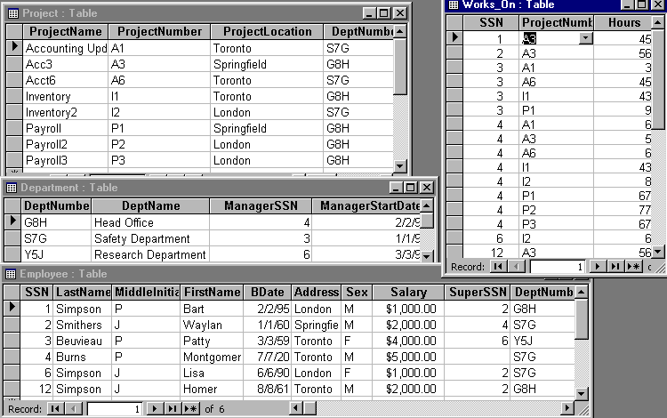
Consider…
Fred needs to know how many people worked more than 40 hours on a project
Sue needs to know who works in the London office
Homer wants to know how many supervising employees make over 2000 dollars
CS3319

Slide 3
Relational Languages
Once we have our relational model, we need to manipulate the data within the model, we use a relational language
Some relational languages are Procedural, they tell us how to get the data (e.g. Relational Algebra)
Some relational languages are Non-Procedural, they tell us what data is needed (e.g. Relational Calculus)
Formally, Relational Algebra is equivalent to Relational Calculus, i.e. every expression in the algebra can be written also in the calculus and vise versa
CS3319

Slide 4
A language that can produce any relation that can be derived using relational calculus is relationally complete.
Most relational query languages are relationally complete and more (i.e. they have additional power to do calculations, ordering, etc.)
Relational algebra is a theoretical language with operations that perform on one or more relations and in turn produce relations based on the operations, thus both the input (operands) and output (results) are relations, i.e. a closed language, i.e. integer - integer produces an integer and a relation - relation produces a relation
CS3319

Slide 5
QUESTION: Do the operations -,+,/,* produce a closed language on integers? YES or NO? WHY?
Because relations are produced, we can use the results in further operations, thus nesting our results, this is called closure; relations are closed under algebra
Relational algebra is a set language, in which all tuples are manipulated in one statement, thus we don't use looping
CS3319

Slide 6
QUESTION: What are the basic operations in arithmetic?
CS3319

Slide 7
5 Basic Operations in Relational Algebra
Selection: Unary (works on 1 Relation only), returns only the tuples from a relation that satisfy the specified condition. (i.e. returns a row subset), written as:
σ _{condition} (R)
Projection: Unary (works on 1 Relation only), returns only the requested attributes (with no duplicates) (returns a column subset), written as:
π _{attribute1, attribute2} (R)
CS3319

Slide 8
Cartesian Product: Binary (requires 2 Relations), returns a relation that is the concatenation of every tuple of relation R with every tuple of relation S, Symbol: S X R
Union: Binary (requires 2 Relations), union of relations R and S with I and J tuples, respectively, is the concatenation of them into one relation with a maximum of I+J tuples, duplicate tuples being eliminated, R and S must be union compatible (i.e. R and S must have the same columns or attribute domains). Symbol: R U S
Set Difference: R-S = a relation consisting of the tuples that are in relation R but not in S, R and S must be union compatible. S - R
CS3319

Slide 9
PROJECTION AND SELECTION
Unary Operations (require only one input)
CS3319

Slide 10
Examples of Projection & Selection
Using the following data:
CS3319

Slide 11
QUESTION: What would be returned with the expression:
σ _{Salary > 3000} (Employee)
The above rewritten as an English question would be: Find all the employee information about employees who make a salary greater than 3000. This is called a QUERY
CS3319

Slide 12
QUESTION: What would be returned with the expression:
π _{LastName, FirstName} (Employee)
QUESTION: Rewrite the question above as a query (English Question):
CS3319

Slide 13
QUESTION: Write the expression to find all project information about projects located in Toronto:
QUESTION: Write the expression to find all department names:
QUESTION: Write the expression to find the address and first name of male employees:
CS3319

Slide 14
QUESTION: Are these the same? YES or NO?
π _{LastName, Sex} (σ _{Bdate > 1/1/70} (Employee))
σ _{Bdate > 1/1/70} (π _{LastName, Sex} (Employee))
CS3319

Slide 15
Sequence of Operations & Rename Operation
Building Temporary Tables
  Can break a series of operation down into separate operation and temporarily rename resulting relations
Example: The following expression:
π _{LastName, Sex} (σ _{BDate > 1/1/70} (Employee))
Can be broken down into:
Temp1 ← σ _{BDate > 1/1/70} (Employee)
Answer ← π _{LastName, Sex} (Temp1)
CS3319

Slide 16
Renaming Attributes:
  You may need to rename attributes to make the names easier to understand and occasionally you MUST rename attributes when performing union and joins.
Example:
Result _{(Lname, MorF)} ← π _{LastName, Sex} (Temp)
CS3319

Slide 17
UNION
DIFFERENCE
CARTESIAN PRODUCT
JOINS
INTERSECTION
DIVISION
Binary Operations:
CS3319

Slide 18
Union
R U S
R and S must be union compatible (i.e. R and S must have the same number of columns and, respectively, the same attribute domains).
Returns all attributes from both tables without repeats
Example:
Temp1 _{(SuperSSN)} ← π _{ManagerSSN} (Department)
Result ← Temp1 U π _{SuperSSN}(Employee)
CS3319

Slide 19
QUESTION: What would the following relational expression result in?
Temp1(Field1) ← π MiddleInitial (Employee)
Temp2(Field1) ← π Sex (Employee)
Result ← Temp1 U Temp2
CS3319

Slide 20
QUESTION: What would the following relational expression result in?
Temp1(Loc) ← πProjectLocation (Project)
Temp2(Loc) ← πAddress (σ LastName = “Simpson” (Employee))
Result ← Temp1 U Temp2
QUESTION: What, in English, does the above expression represent?
CS3319

Slide 21
Difference
R – S
R and S must be union compatible (i.e. R and S must have the same number of columns and, respectively, the same attribute domains).
Consists of all the tuples that are in R but do not exist in S
Example:
π_{LastName}(Employee)–π_{LastName}(σ_{LastName=“Simpson”}(Employee))
CS319

Slide 22
QUESTION: What would the following relational expression result in?
Temp1 (SSN) ← π ManagerSSN (Department)
Temp2 (SSN) ← π SuperSSN (Employee)
Result ← Temp1 – Temp2
CS319

Slide 23
QUESTION: What would the following relational expression result in?
Temp1 (SSN) ← π ManagerSSN (Department)
Temp2 (SSN) ← π SuperSSN (Employee)
Result ← Temp2 – Temp1
CS319

Slide 24
QUESTION: What, in English, does the above first expression represent?
QUESTION: What, in English, does the above second expression represent?
QUESTION: Write the expression to show all the project names EXCEPT for the project located in London?
CS319

Slide 25
Cartesian Product
R X S
Concatenation of every tuple of relation R with every tuple of relation S
New table contains all attributes from both S and R
CS319

Slide 26
Example of Cartesian Product:
Table BB:
Table AA:
A | D
Horse | 11
Pig | 22
Pig | 33
A | B | C
11 | Pig | Cat
22 | Dog | Cat
AA X BB
AA.A | B | C | BB.A | D
11 | Pig | Cat | Horse | 11
22 | Dog | Cat | Horse | 11
11 | Pig | Cat | Pig | 22
22 | Dog | Cat | Pig | 22
11 | Pig | Cat | Pig | 33
22 | Dog | Cat | Pig | 33
CS319

Slide 27
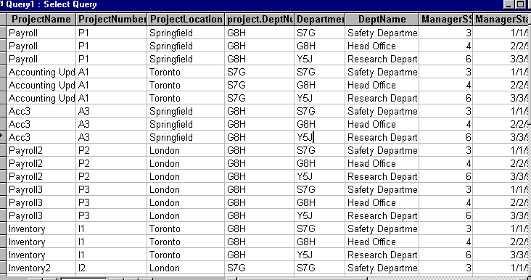
Department X Project:
QUESTION: How many tuples are above?
Where did the number of tuples come from?
CS319

Slide 28
QUESTION: What would the following relational algebra expression result in?
Temp1 (LastName, FN)← π LastName, FirstName (σ SSN > 4 (Employee))
Temp2 ← π FirstName, Salary, Sex (σ Sex = “M” (Employee))
Result ← Temp1 X Temp2
CS319

Slide 29
QUESTION: What would the following relational algebra expression result in?
Temp1 ← π DeptName, ManagerSSN (Department)
Temp2 ← π LastName, FirstName, SSN (Employee)
Result ← Temp2 X Temp1
CS319

Slide 30
QUESTION: Do you notice any patterns in the resulting relationship (Hint: Look for attributes that are equal)
QUESTION: Suppose I asked you to give me the name of the managers of the departments, how could you use the above result to answer my query (question)?
CS319

Slide 31
Joins
R ⋈ S
Joins are just Cartesian Products with a select after the Cartesian product to eliminate some tuples
R ⋈ _{Boolean formula} S: Produces a relation that contains tuples satisfying a condition from the Cartesian Product of R X S where the formula can contain comparisons using one of <,<=,>,>=,=,<> connected by and, or and not
Example:
Department ⋈ _{ManagerSSN = SuperSSN} Employee
CS319

Slide 32
Equi Join: when all of the comparisons are =, then it is called an equi join
  Often, all of the common attribute names are the same, and are the ones you want to join over.
  In this case, you do not have to give the attribute names, it just compares attributes with the same name for equality. This is called a Natural Join. In most books, it is denoted by ⋈.
  In Navathe and Elmasri, it is denoted by *.
  Example: Department ⋈ Project
    Will join on = values for DeptNumber, which is the common attribute
CS319

Slide 33
Full Outer Join: R S: a join in which tuples from R that do not have matching values in the common columns of S still appear and tuples in S that do not have matching values in the common columns of R still appear in the resulting relation (padding the fields with nulls)
Left Outer Join: R S : a join in which tuples from R that do not have matching values in the common columns of S still appear in the resulting relation
Right Outer Join: R S: tuples in S that do not have matching values in the common columns of R still appear in the resulting relation.
CS319

Slide 34
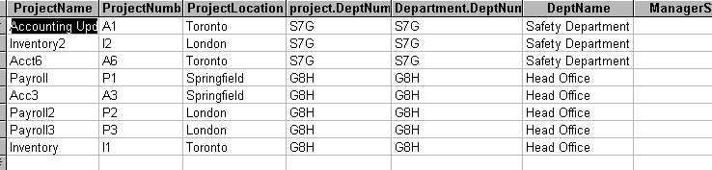
Examples of Joins:
Example 1:
Equi Join on Department and Project:
Project ⋈ Project.DeptNumber = Department.DeptNumber Department
CS319

Slide 35
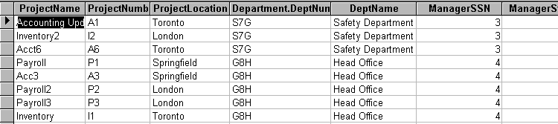
Example 2:
Natural Join on Department and Project:
Project ⋈ Department
CS319

Slide 36
QUESTION: What will be the resulting table of the following relational algebra expression?
π _{LastName, DeptName} (Employee ⋈ Department)
QUESTION: What does the above result represent in English?
CS319

Slide 37
QUESTION: What will be the difference that will result in the answers in the following two relation algebra expressions?
Expression 1: Employee ⋈ Department
Expression 2: Employee ⋈ _{DeptNumber = DeptNumber} Department
CS319

Slide 38
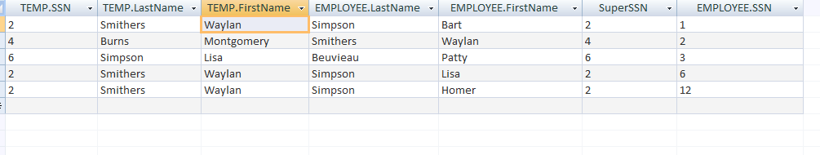
QUESTION: What will the following expression return?
Temp(LN, FN, SSN) ← π _{LastName,FirstName,SSN} (Employee)
Result ← Temp⋈_{SSN=SuperSSN}(π LastName,FirstName,SSN,SuperSSN(Employee))
QUESTION: In English, what does the above expression represent?
CS319

Slide 39
Reminder of the data:
CS3319

Slide 40
QUESTION: Write the Relational Algebra expression to print the department name, and the manager's first and last name:
π _{DeptName, LastName, FirstName} (Employee ⋈ _{SSN = ManagerSSn} Department)
QUESTION: Write the Relational Algebra expression to display department names of departments who have people making more than 4,000 dollars.
TEMP ← π _{DeptNumber} (σ _{Salary > 4000} (Employee))
ANSWER← π _{DeptName} (TEMP ⋈ Department)
CS319

Slide 41
QUESTION: Write the Relational Algebra expression to print the first and last name of all employees, the name of the projects they work on and the number of hours they work on each project. (This is a join for a many to many relationship)
TEMP ← π FirstName, LastName, ProjectNumber,Hours (EMPLOYEE ⋈ WORKSON)
ANSWER← π FirstName, LastName,Hours,ProjectName (TEMP ⋈ PROJECT)
CS319

Slide 42
Natural Join More Info:
If the two tables being joined have the same attribute name, it is a natural join and the attribute will only show up ONCE in the resulting table
The natural join includes EACH pair of attributes with the same name, “AND” ed together, for example:
  Q ← R(A,B,C,D) ⋈ S(C,D,E)
  Result would only keep one copy of each pair
    R.C=S.C AND R.D = S.D
  and would give: Q(A,B,C,D,E)
CS3319

Slide 43
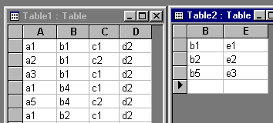
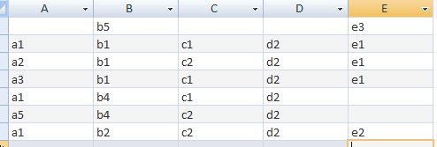
Example: Outer Join
QUESTION: What will the following expression result in?
Table1 Table2
CS319

Slide 44
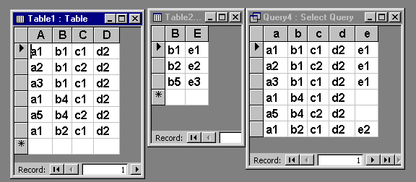
Example: Left Outer Join
Table 2
Table 1
Table1 Table2
CS319

Slide 45
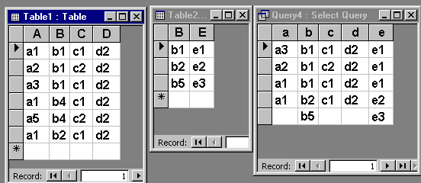
Example: Right Outer Join
Table1 Table2
Might use an outer join for example in a situation like:
Find the name of all employees and list the department name if they also manage a department.
QUESTION: Write the relational algebra for the above situation:
TEMP ← Department _{ManagerSSN=SSN}Employee
ANSWER← π _{FirstName,LastName,DeptName} (TEMP)
CS319

Slide 46
Intersection
R ∩ S
consists of the set of all tuples that are in both R and S
  The 2 relations must be union compatible
  Intersection can be expressed as:
    (R U S) - ((R - S) U (S - R))
CS319

Slide 47
Example of Intersection:
Table BB:
Table AA:
B
b2
b7
b13
QUESTION: What will AA ∩ BB return?
B
b1
b2
b7
b8
b11
b16
CS319

Slide 48
useful in situation with the word both or and, such as list the people who work on BOTH project X and project Y
ProjectX ← π _{ProjectNumber} (σ _{ProjectName = “X”} (Project))
ProjectY ← π _{ProjectNumber} (σ _{ProjectName = “Y”} (Project))
WorksOnX ← π _{SSN} (ProjectX ⋈ Works_On)
WorksOnY ← π _{SSN} (ProjectY ⋈ Works_On)
Answer ← π _{LastName} ((WorksOnX ∩ WorksOnY) ⋈ Employee)
CS319

Slide 49
QUESTION: Write the relational algebra to find the project name of all projects that Simpson AND Smithers work on:
TempSimp ← π_{SSN} (σ_{LastName= “Simpson”} (Employee))
TempSmit ← π_{SSN} (σ_{LastName= “Smithers”} (Employee))
WorksOnSimp ←π_{ProjectNumber} (TempSimp ⋈ Works_On)
WorksOnSmit ←π_{ProjectNumber} (TempSmit ⋈ Works_On)
Answer ←π_{ProjectName}((WorksOnSimp∩WorksOnSmit) ⋈ Project)
CS319

Slide 50
Division
R ÷ S
Consists of the set of tuples from R that match every tuple in S
  If you are doing R(Z) divided by S(X) where Z and X are the respective sets of attributes of R and S, then X must be a subset of Z. Let Y = Z - X (therefore Z = X U Y), thus Y is the set of attributes that is:
  ____________________________
  Then the result of the division is a relation T(Y) where a tuple is in T(Y) ONLY if it the Y attributes combined with every tuple in S can be found in R.
  Division is equivalent to a sequence of projections, Cartesian product and difference operators as follows:
L1 ← π y (R)
L2 ← π y ((S x L1) - R)
L ← L1 – L2
The set of attributes of R that are not attributes of S
CS319

Slide 51
Division continued…
The result of DIVISION is a relation T(Y) that includes a tuple t if tuples tR appear in R with tR [Y] = t, and with tR [X] = ts for every tuple ts in S.
For a tuple t to appear in the result T of the DIVISION, the values in t must appear in R in combination with every tuple in S.
CS3319

Slide 52
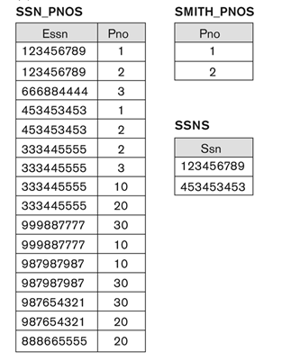
Type of query might be: Find SSN’s of people who work on all of Smith’s projects
Result of: SSN_PNOS ÷ SMITH_PNO
CS3319

Slide 53
Example of Division:
Table AA:
QUESTION: What will AA ÷ BB return?
A | B
a1 | b1
a2 | b1
a3 | b1
a4 | b1
a1 | b2
a3 | b2
a2 | b3
a3 | b3
a4 | b3
a1 | b4
a2 | b4
a3 | b4
Table BB:
A
a1
a2
a3
CS319

Slide 54
Useful for situations where the term "ALL" is used, for example:
  Find the first and last names of employees who work on all the projects that Dave Leno works on.
  the answer would be like this:
Leno_{(ESSN)} ← π _{SSN} (σ _{LastName = “Leno”} (Employee))
Leno_Proj ← π _{ProjectNumber} (Works_On ⋈ _{SSN = ESSN} Leno)
SSN_Proj _{(ESSN,PNO)} ← π _{SSN, PNO}(Works_On)
LSSNPROJ (SSN) ← SSN_PROJ ÷ Leno_Proj
Result ← π _{FirstName,LastName} (LSSNPROJ ⋈ Employee)
CS319

Slide 55
QUESTION: Write the relational algebra to find the project names of any projects that also have all the employees working on them that work on the project named “Acct6”.
Acct6 _{(ESSN)} ← π_{ProjectNumber}(σ_{ProjectName=“Acct6”}(Project))
Acct6_Emp ← π_{SSN}(Works_On ⋈ Acct6)
ProjNums ← π_{SSN,ProjectNumber}(Works_On)
AllAcct6 ← ProjNums ÷ Acct6_Emp
Result ← π_{ProjectName} (AllAcct6⋈ Project)
CS319

Slide 56
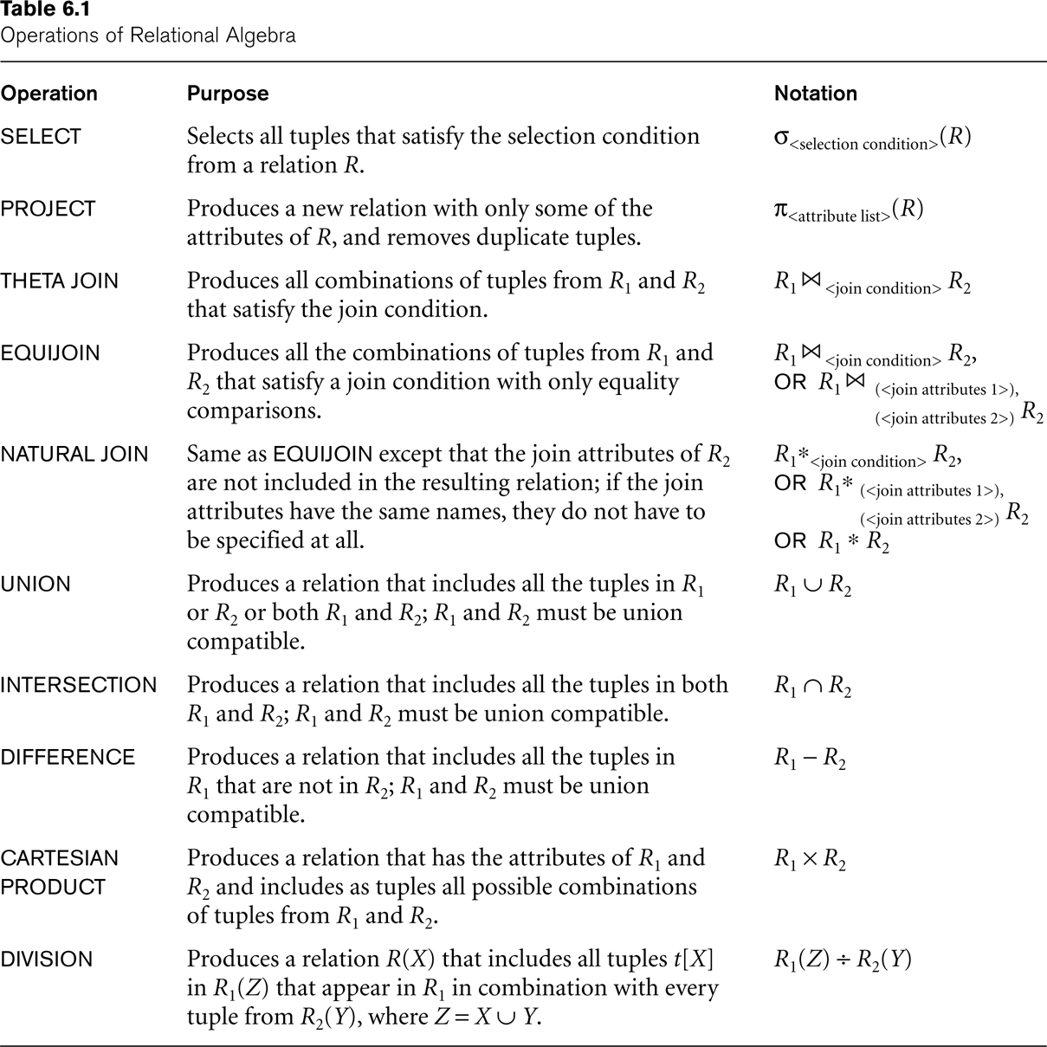
Summary of Operations
CS3319

Slide 57
Final Review Questions
QUESTION: Write the query to find all the employees names and addresses who work in Head Office
QUESTION: Write the query to list the name of each project, along with the name of the department it is assigned to, along with that department managers lastname.
CS319

Slide 58
QUESTION: Retrieve the names of employees who have no dependents.
ALL_EMPS ← π SSN(EMPLOYEE)
EMPS_WITH_DEPS(SSN) ← π ESSN(DEPENDENT)
EMPS_WITHOUT_DEPS ← (ALL_EMPS - EMPS_WITH_DEPS)
RESULT ← π LNAME, FNAME (EMPS_WITHOUT_DEPS EMPLOYEE)
CS3319

Slide 59
Use the following two tables to answer the following questions:
Table AA:
Table BB:
A | B | C | D
2 | 22 | y | z
2 | 33 | x | x
1 | 22 | x | y
1 | 11 | w | x
E | F | D
1 | 44 | z
2 | 44 | x
2 | 33 | x
CS319

Slide 60
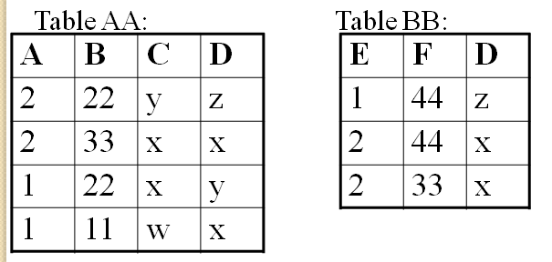
QUESTION: How many attributes will the following query return?
AA BB
QUESTION: How many tuples? List those tuples:
CS319

Slide 61
QUESTION: How many attributes will the following query return?
AA _{C=D}BB
QUESTION: How many tuples? List those tuples:
CS319

Slide 62
QUESTION: How many attributes will the following query return?
AA BB
QUESTION: How many tuples? List those tuples:
CS319

Slide 63
QUESTION: How many attributes will the following query return?
AA BB
QUESTION: How many tuples? List those tuples:
CS319

Slide 64
QUESTION: How many attributes will the following query return?
AA BB
QUESTION: How many tuples? List those tuples:
CS319

Slide 65
QUESTION: How many attributes will the following query return?
π _{D} (AA) ∩ π _{D} (BB)
QUESTION: How many tuples? List those tuples:
CS319

Slide 66
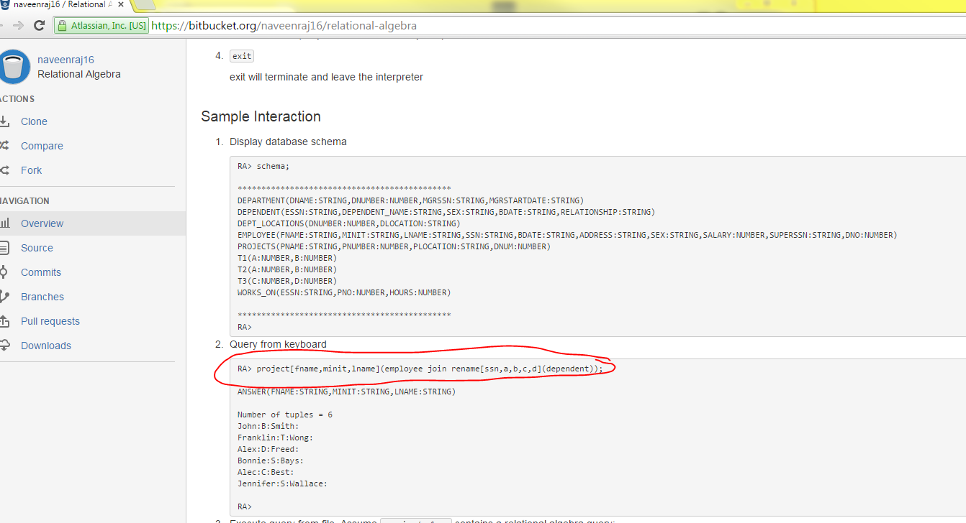
Interesting Project – Relational Algebra Interpreter
Website: https://bitbucket.org/naveenraj16/relational-algebra
  “This open source project provides an implementation of a relational algebra interpreter. This is a useful tool in introductory database courses where querying through relational algebra is covered. The interpreter assumes a MySQL database. The relational algebra queries are executed over the tables of the MySQL database.”
CS3319

